Slide 1

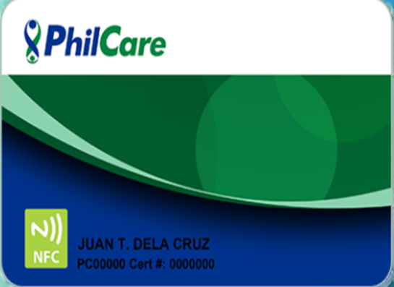




Ang Health Plan para sa Masa at Lipunan
Product is underwritten by: Philcare Inc.

Slide 2
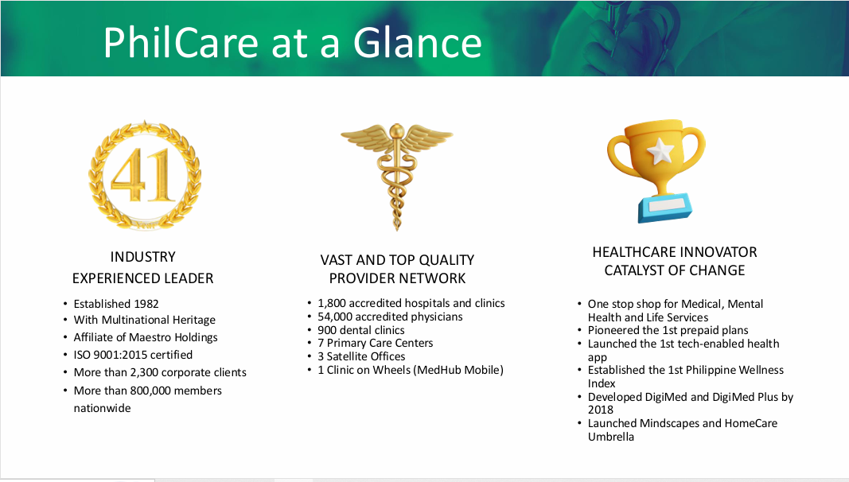

Slide 3


Slide 4
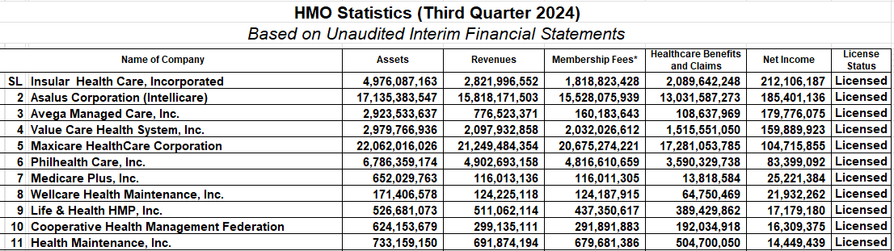

Slide 5

BENEFIT ANNUALY PHP 7,000.00
Benefits
50K ANNUAL BENEFITS LIMIT
WARD ROOM
INPATIENT|OUTPATIENT|EMERGENCY|MENTAL HEALTH CARE
OP UNLI CONSULTATION | OP CLINIC BASED
APE (ANNUAL PHYSICAL EXAM)
20% PRE EXISTING COVERAGE
1,800 AFFILIATED HOSPITALS & CLINICS
49,000 AFFILIATED PHYSICIANS
HEYPHIL APP| NFC |MEMBERS GATEWAY
WELLNESS BUDDIES

Slide 6

CORE
BENEFITS
ADDITIONAL
BENEFITS
Out•
Patient Care
{Clinic-Based)
Emergency
Care
In-Patient
Care Medical care that requires hospital admission and strict monitoring of current health condition
APE - Annual
Examination
Physical
Acute care for
sudden, severe conditions causing immediate disability or death
MindCare - Support mental well•
being, including mindfulness,
self-care, and stress management
Medical care
that does not

Slide 7
FULL HEALTH BENEFITS ANNUAL PHYSICAL EXAMINATION
Benefits
Taking of Medical History and Physical Examination | Covered
Complete Blood Count (CBC) | Covered
Chest X-Ray | Covered
Routine Urinalysis | Covered
Routine Fecalysis | Covered

Slide 8
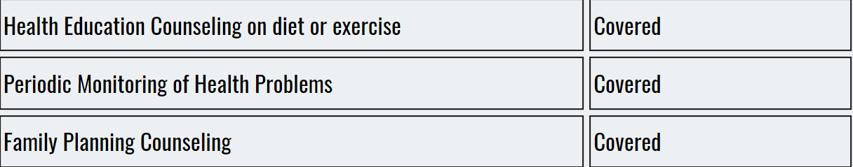
PREVENTIVE HEALTH CARE
Benefits

Slide 9
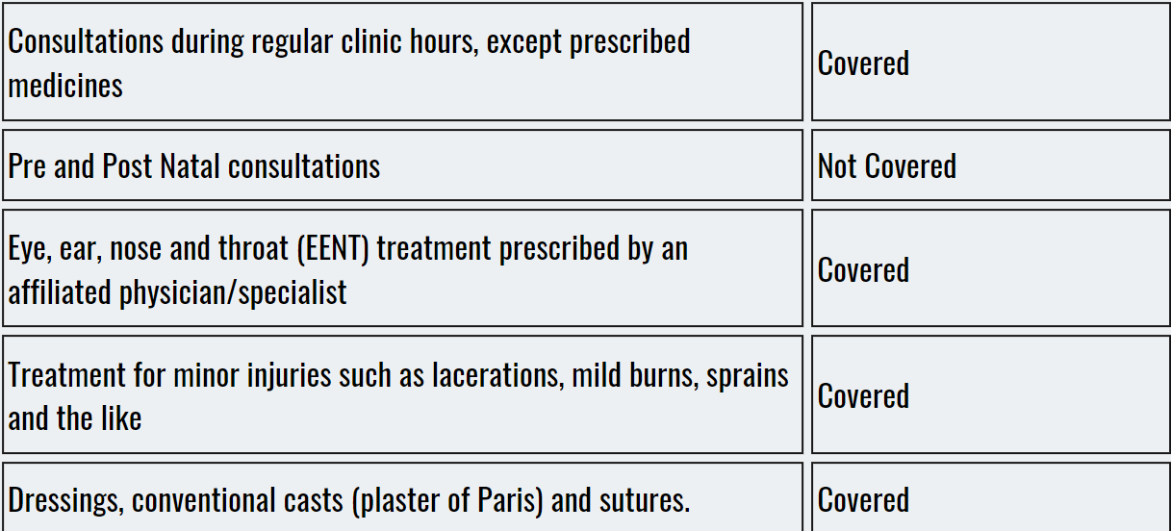
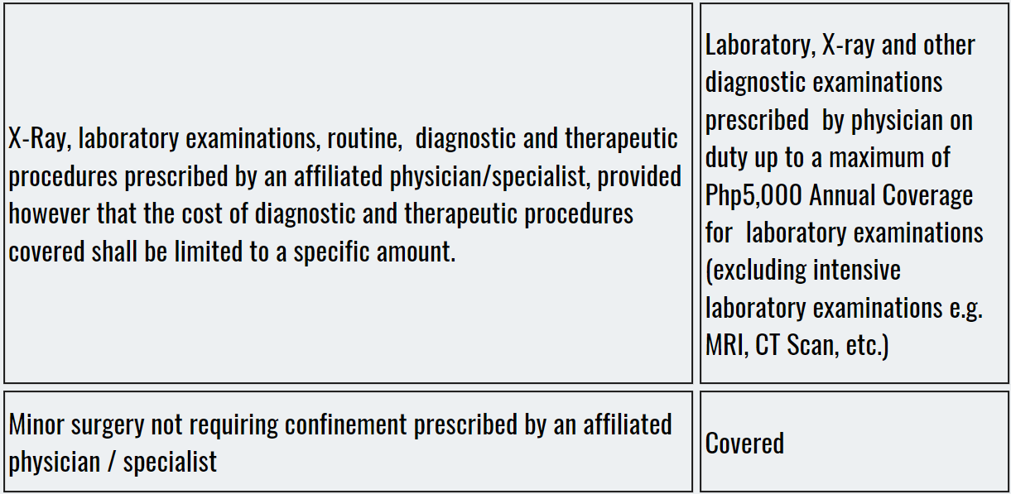
OUT-PATIENT CARE
Benefits

Slide 10
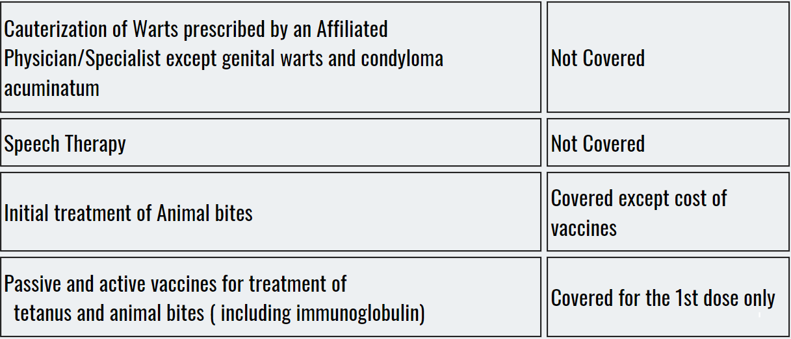

OUT-PATIENT CARE
Benefits

Slide 11
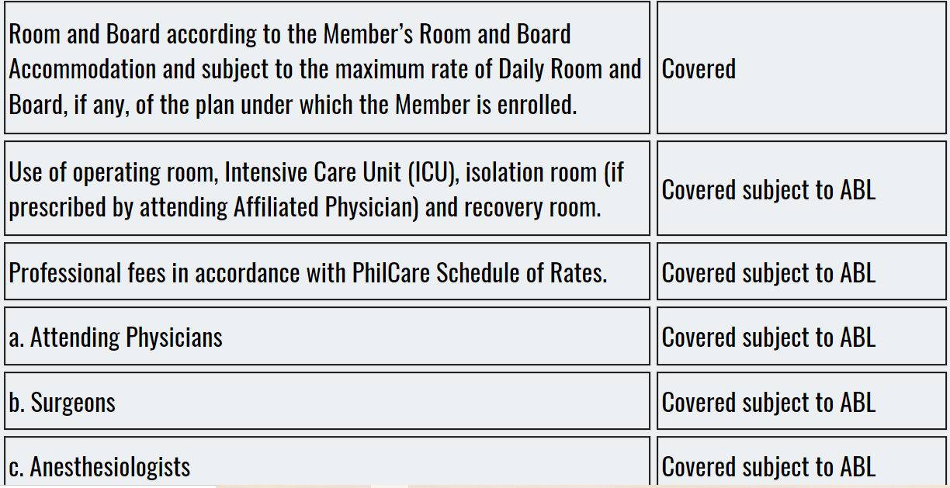
IN-PATIENT SERVICES
Benefits

Slide 12
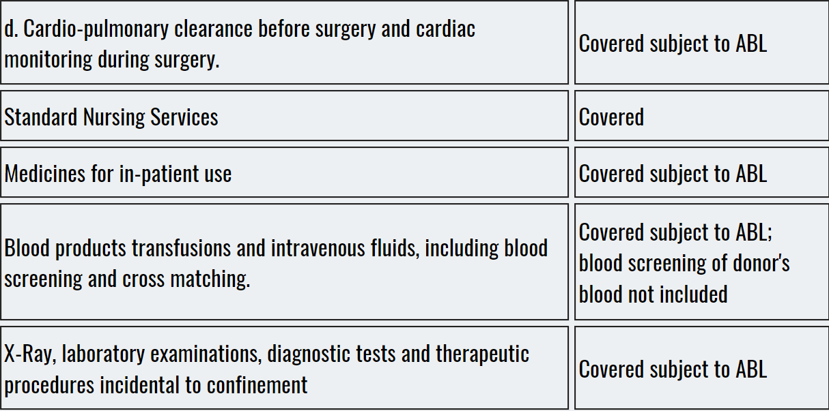
IN-PATIENT SERVICES
Benefits

Slide 13
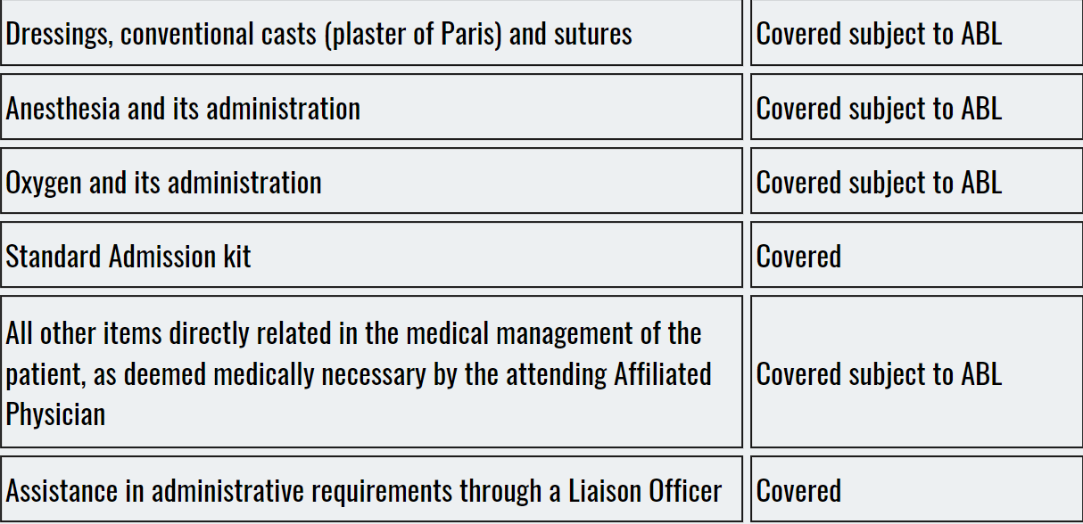
Benefits

Slide 14
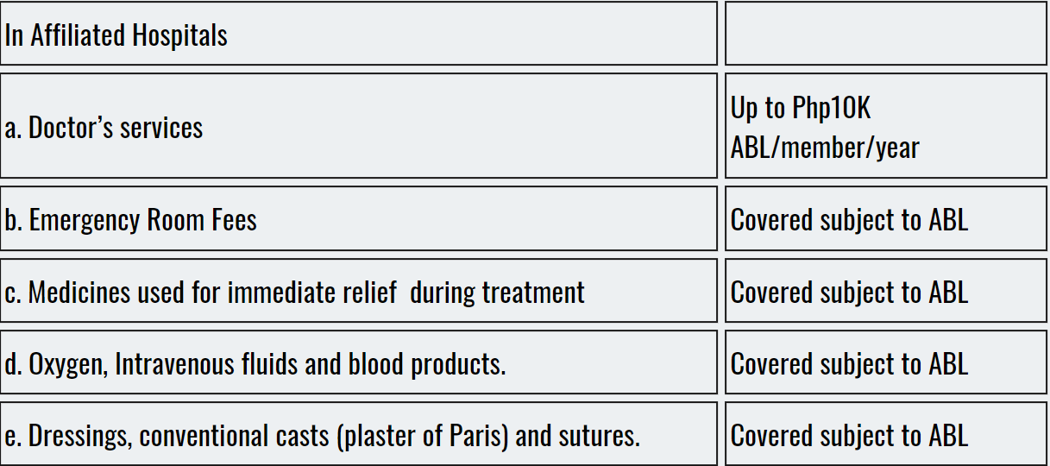

EMERGENCY CARE
Benefits

Slide 15
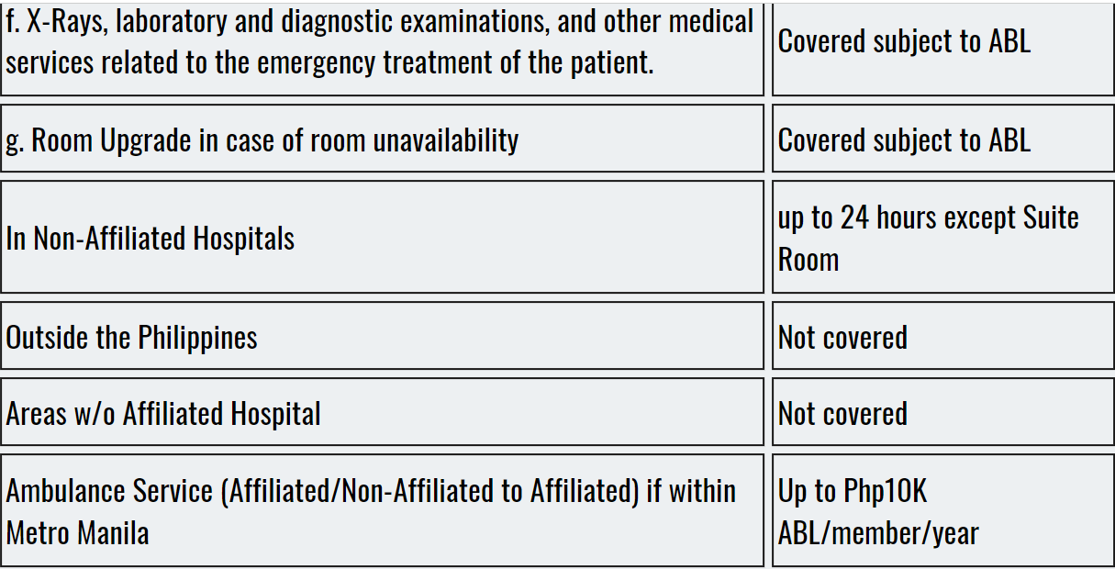
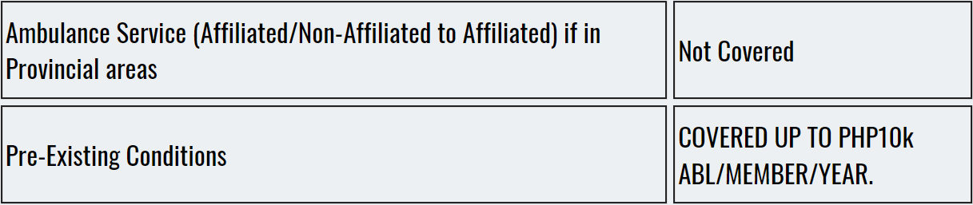

Slide 16
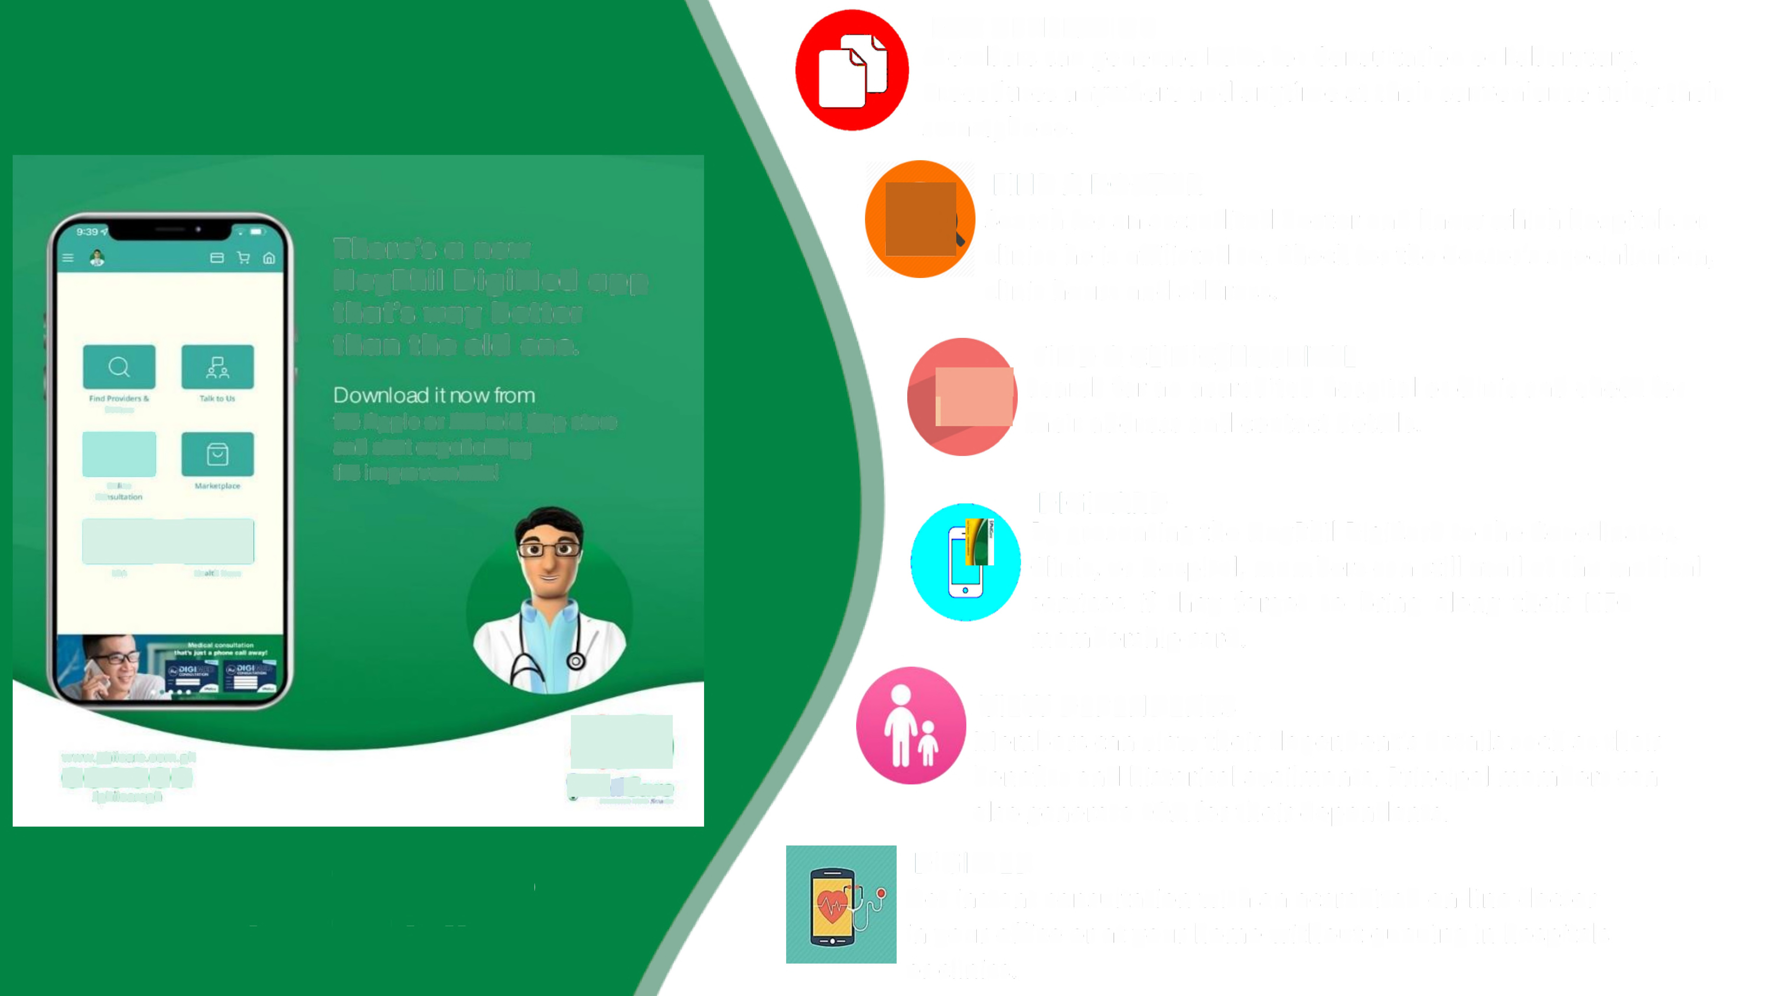
LOA GENERATION
Members can generate LOAs for Consultation or Laboratory.
Procedures anywhere and anytime at their convenience using their smartphone.
£
FIND A DOCTOR
Search for an accredited doctor and know which hospitals or
clinics he is affiliated to. Check for the doctor's specialization,
clinic hours and address.
There's a new
HeyPhil DigiMed app
that's way better
than the old one.
'
FIND A CLINIC/HOSPITAL
search for an accredited hospital or clinic and check for
eeir address and contact details.
'gji@
[TLI
Doctor
the Apple or Android App store
and start experiencing
the improvements!
-^{Owl.r}
Ca
DIGICARD
By presenting the HeyPhil DigiCard to the Coordinator,
Clinic, or Hospital, members can still avail of the medical
EI
LOA
Me, h News
services
if they forgot to
bring
along their
NFC
membership card.
4@e
PilCare
VIEW DEPENDENTS
Members can view their dependent's details such as their
benefits and historical availments. Principal members can
also generate LOA for their dependents.
DIGIMED
Get instant consultation with an accredited on-line doctor
in your office or at your home without queuing in hospitals
or clinics.
www.philcare.com.ph
0@oo
/philcareph
freer the me
HEYPHILAPP

Slide 17
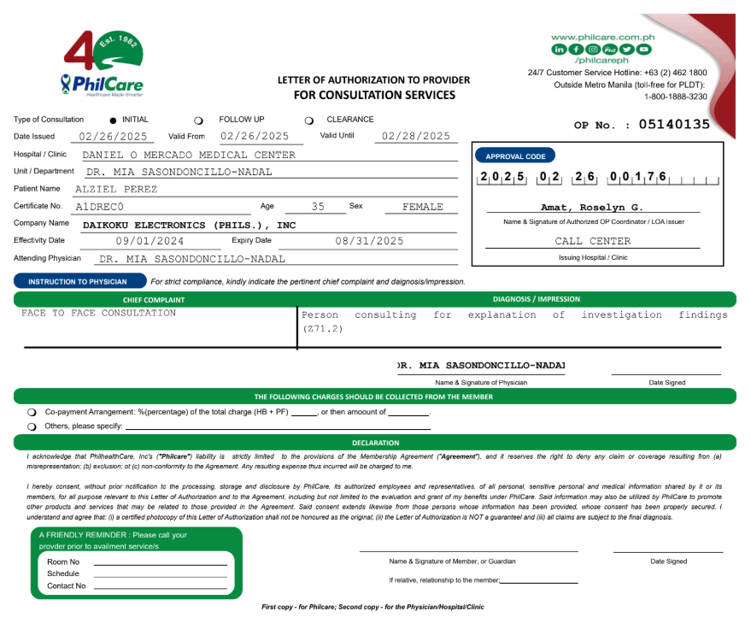
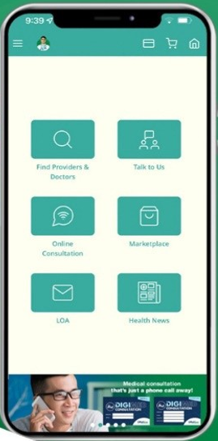
Skip The Line
Get Advance LOA

Slide 18
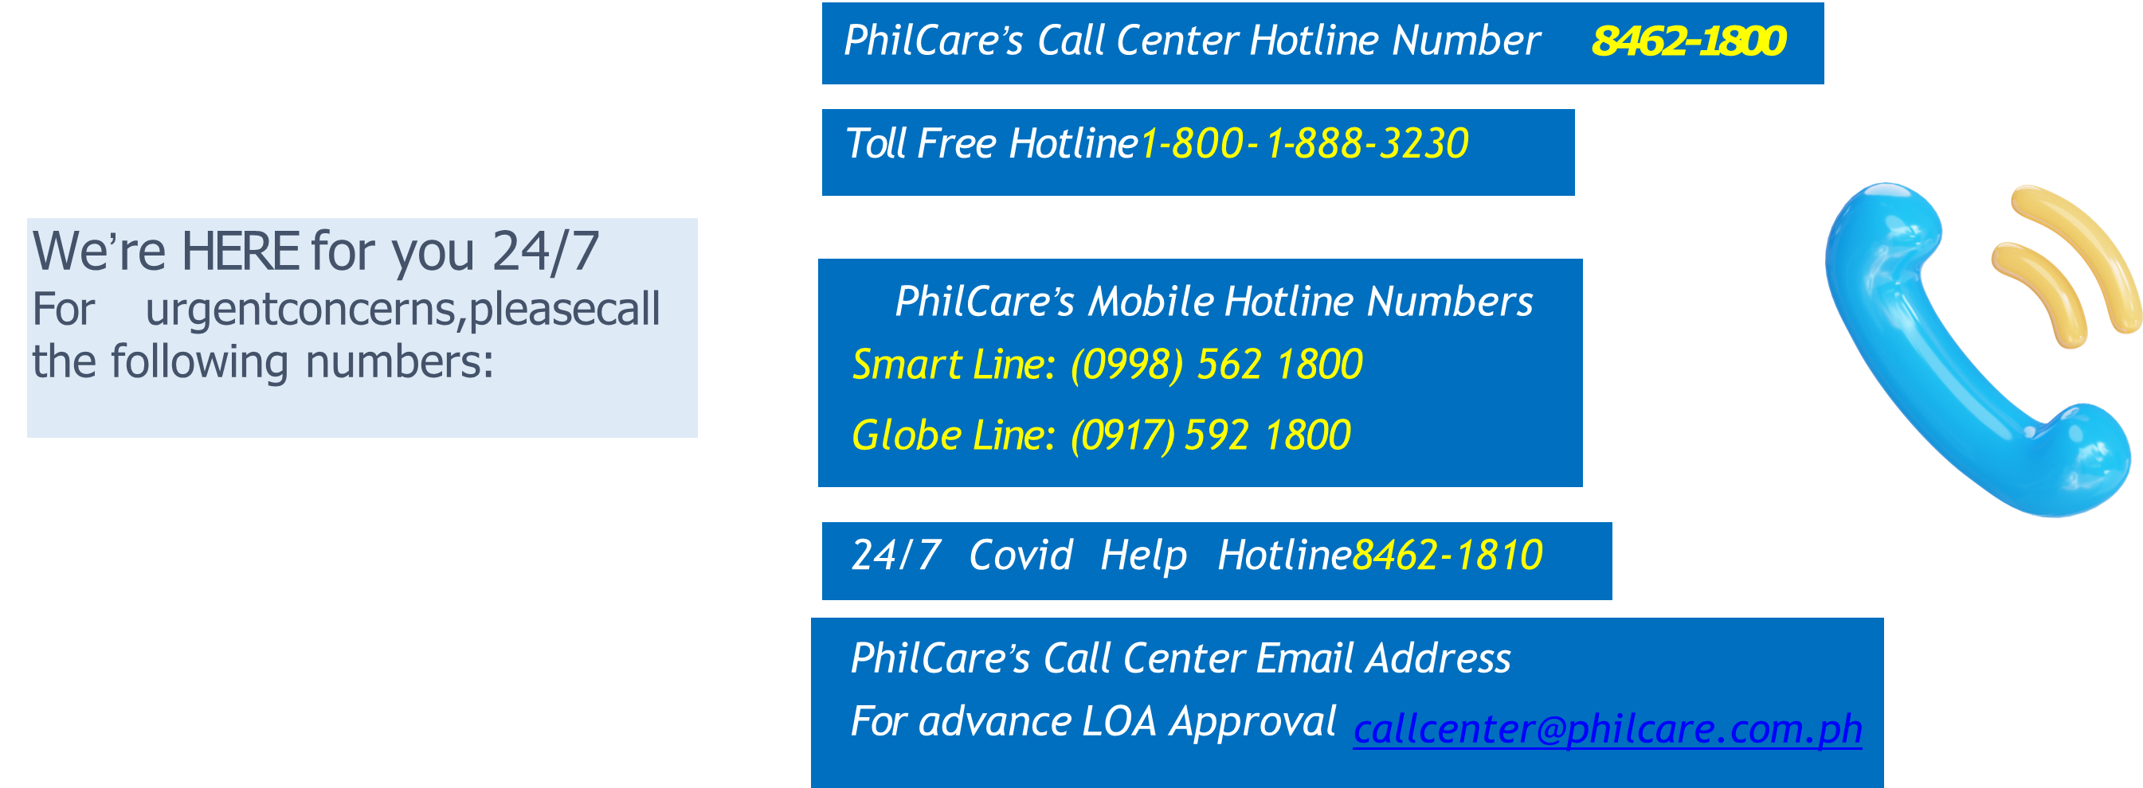
FOR HEALTHCARE AVAILMENT CONCERNS

Slide 19
Accredited Hospitals & Clinics
Region IV - A CALABARZON

Slide 20
Benefits
Accredited
Hospitals & Clinics
Batangas City

Slide 21
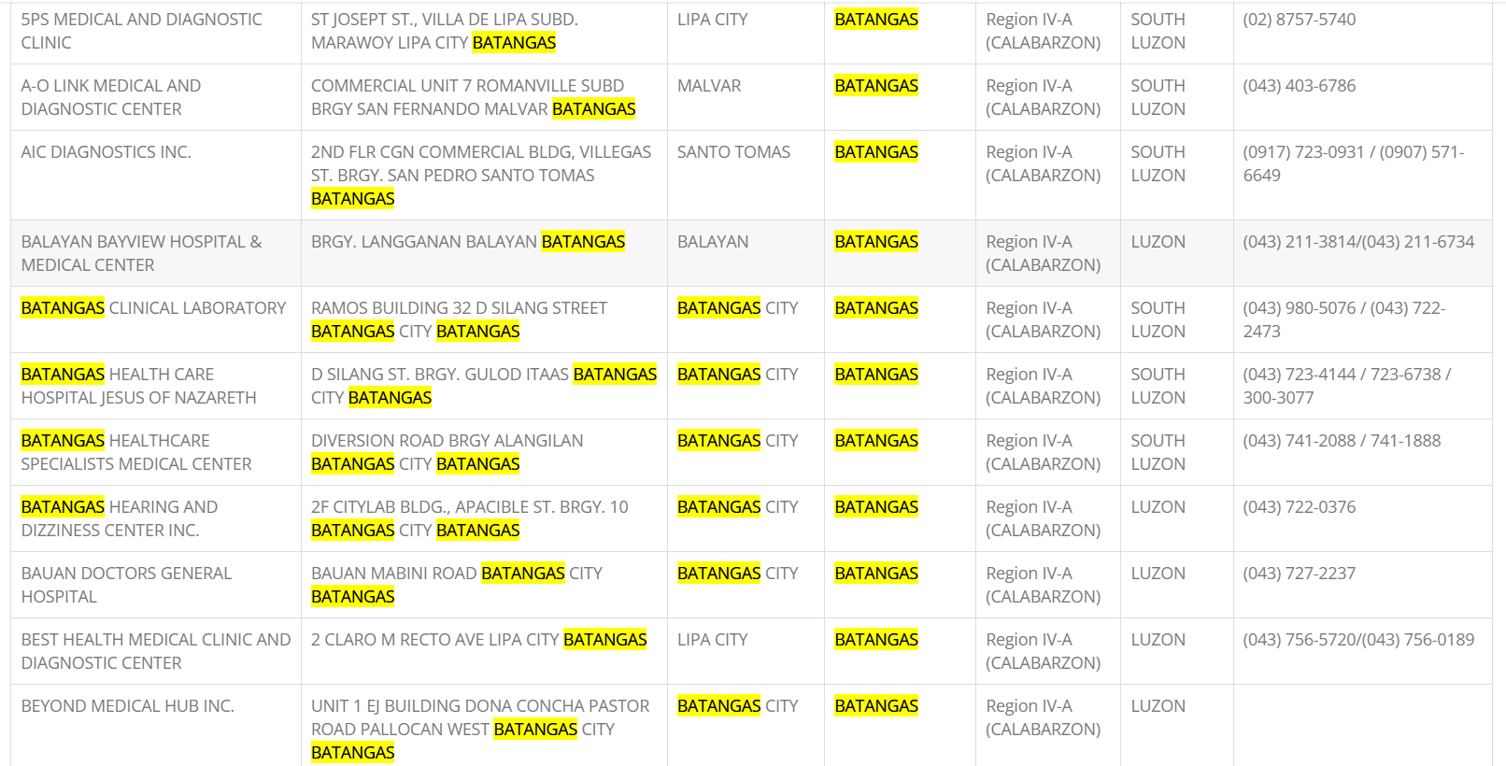

Slide 22
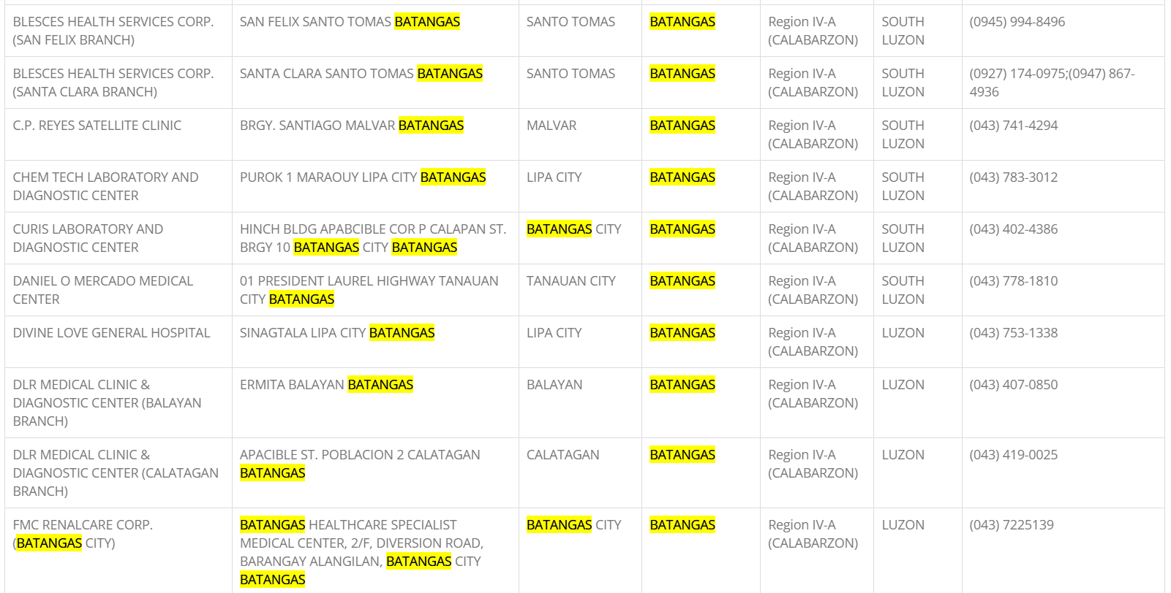

Slide 23
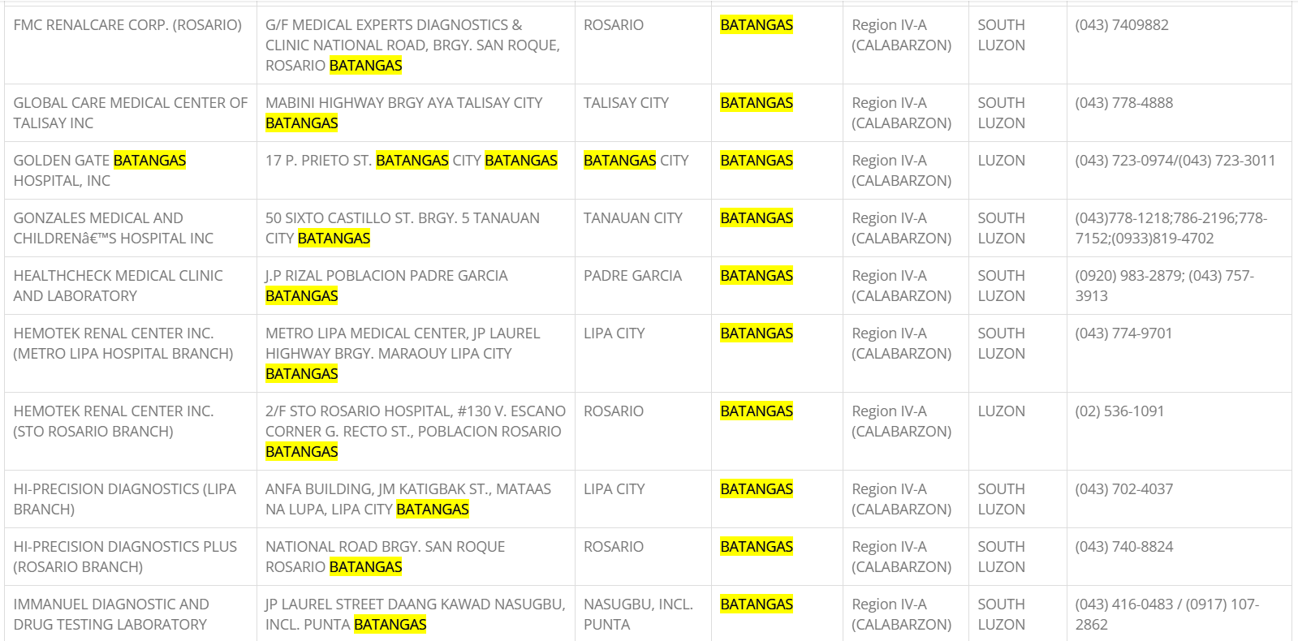

Slide 24
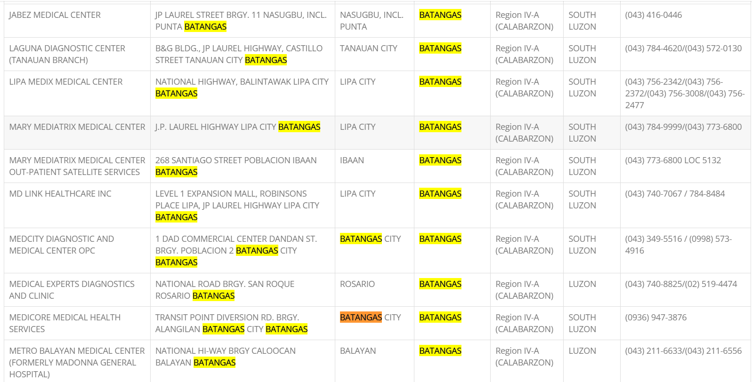

Slide 25
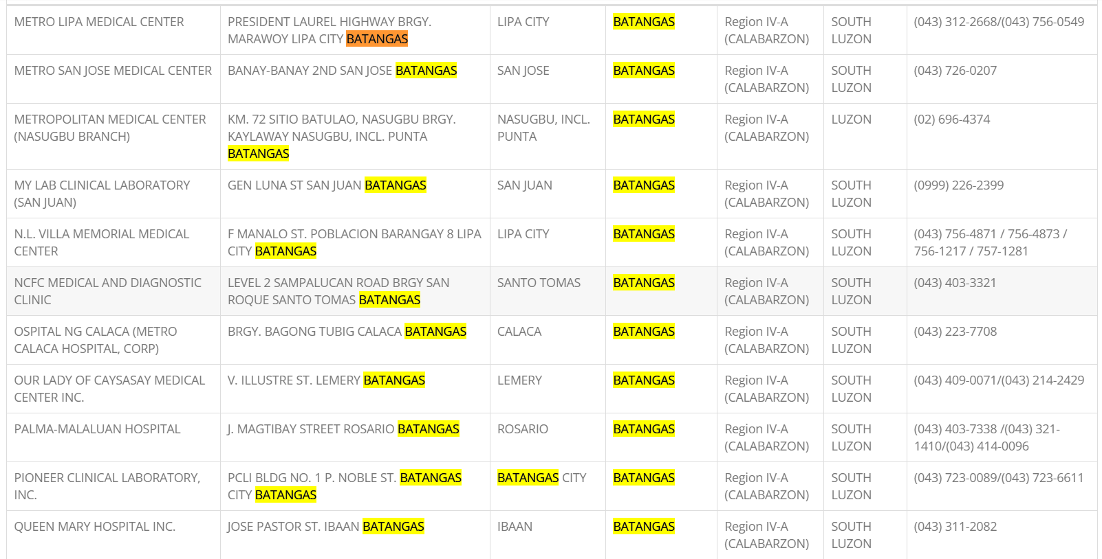

Slide 26
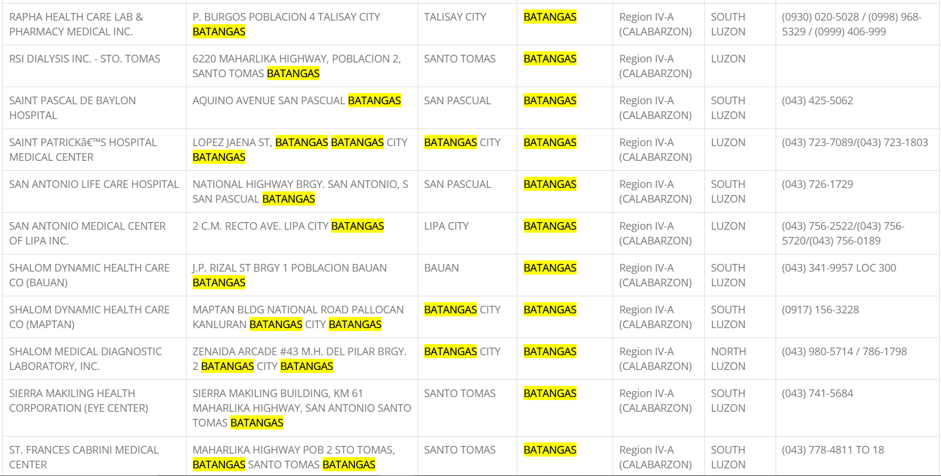

Slide 27
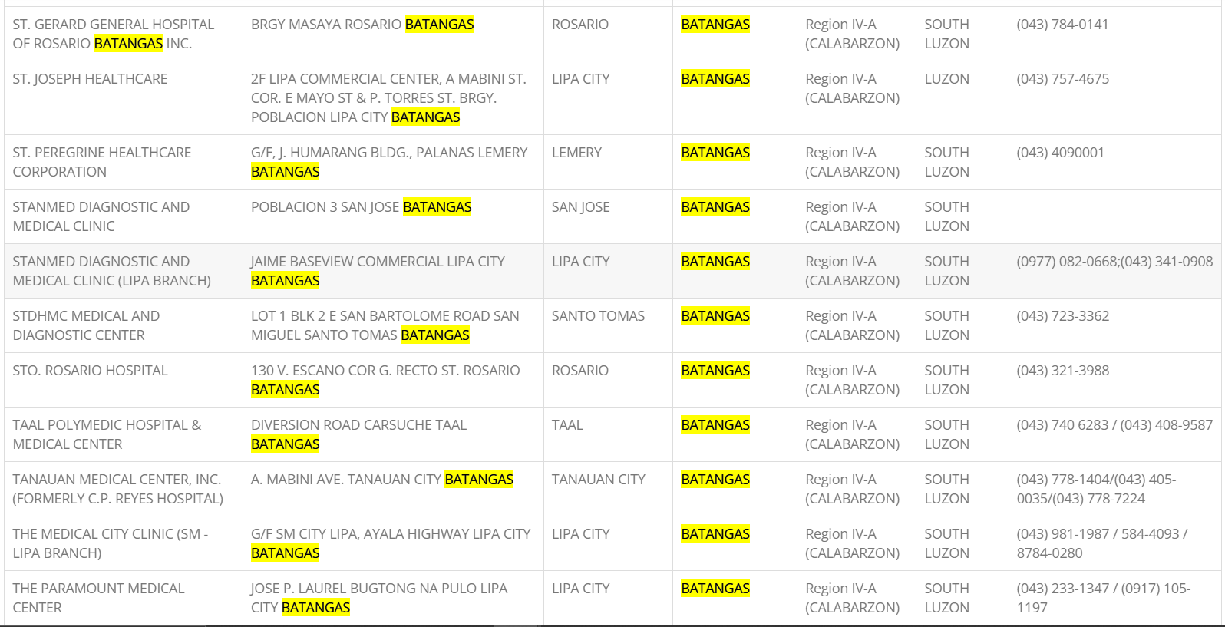

Slide 28
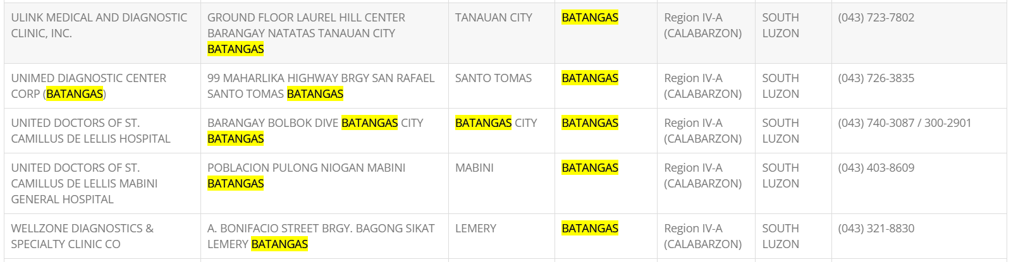

Slide 29
Accredited - Hospitals
Cavite

Slide 30
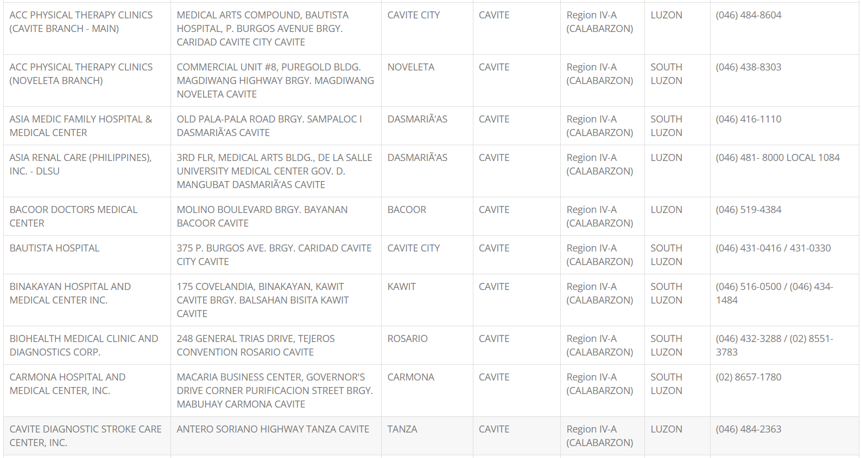

Slide 31
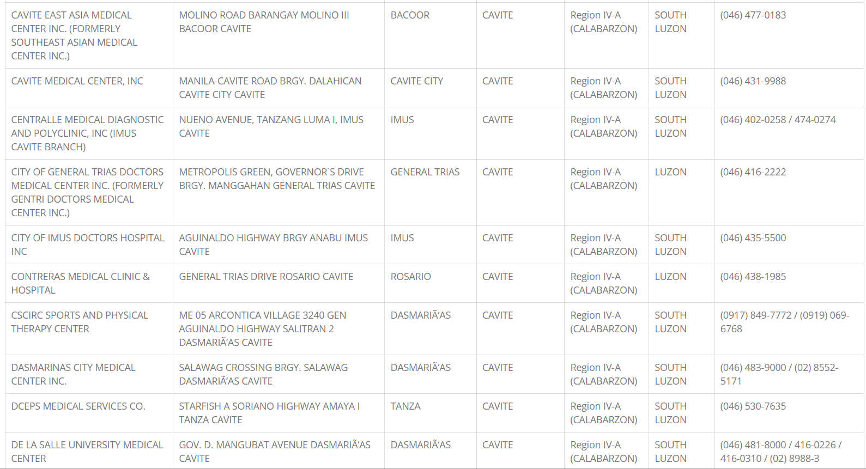

Slide 32
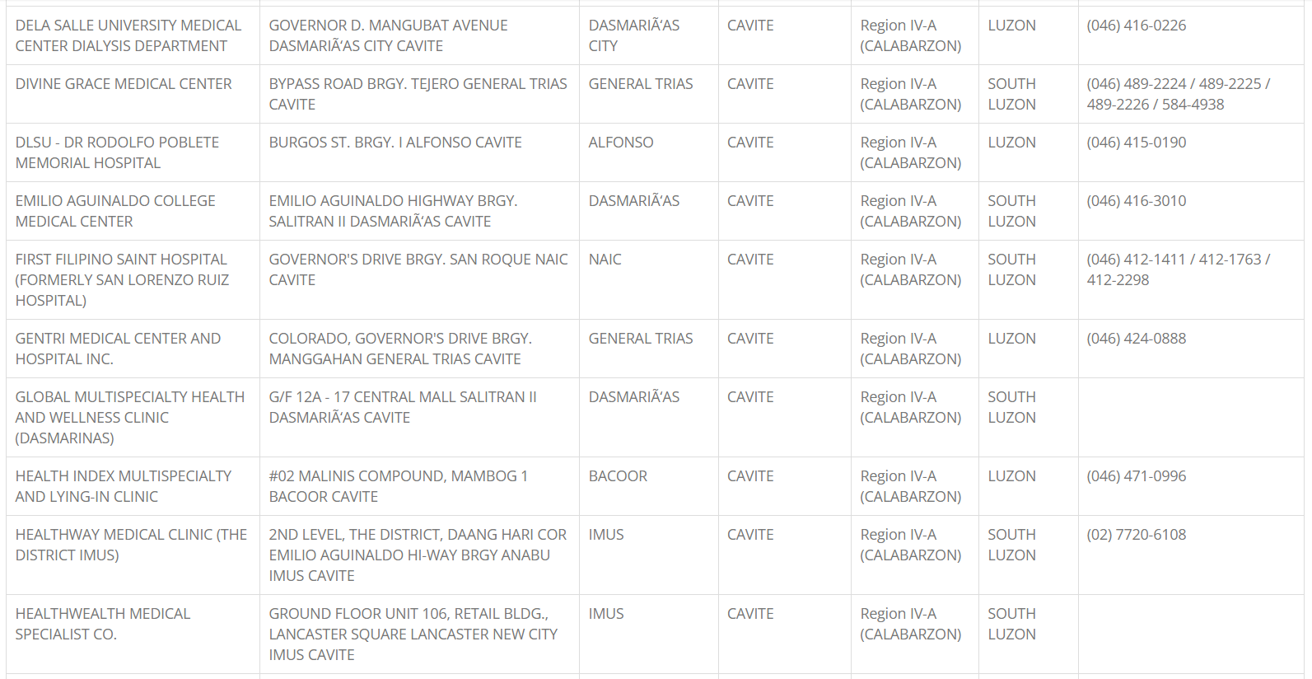

Slide 33
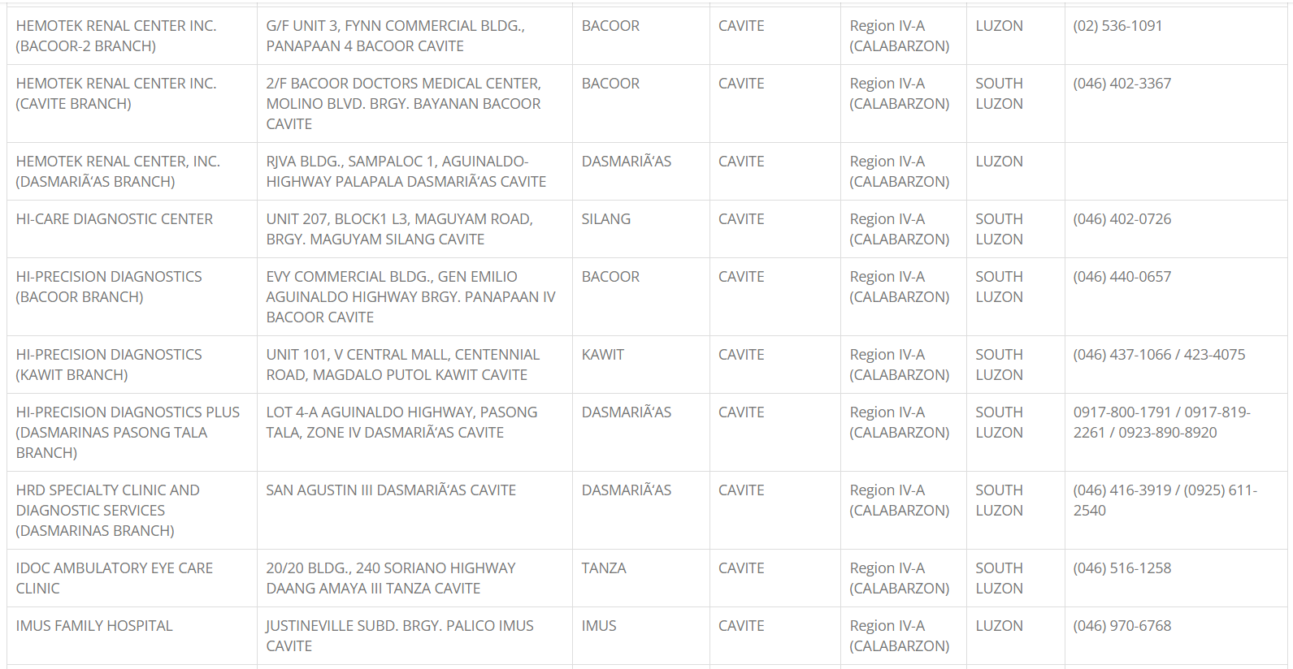

Slide 34
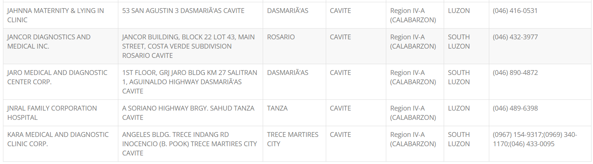

Slide 35
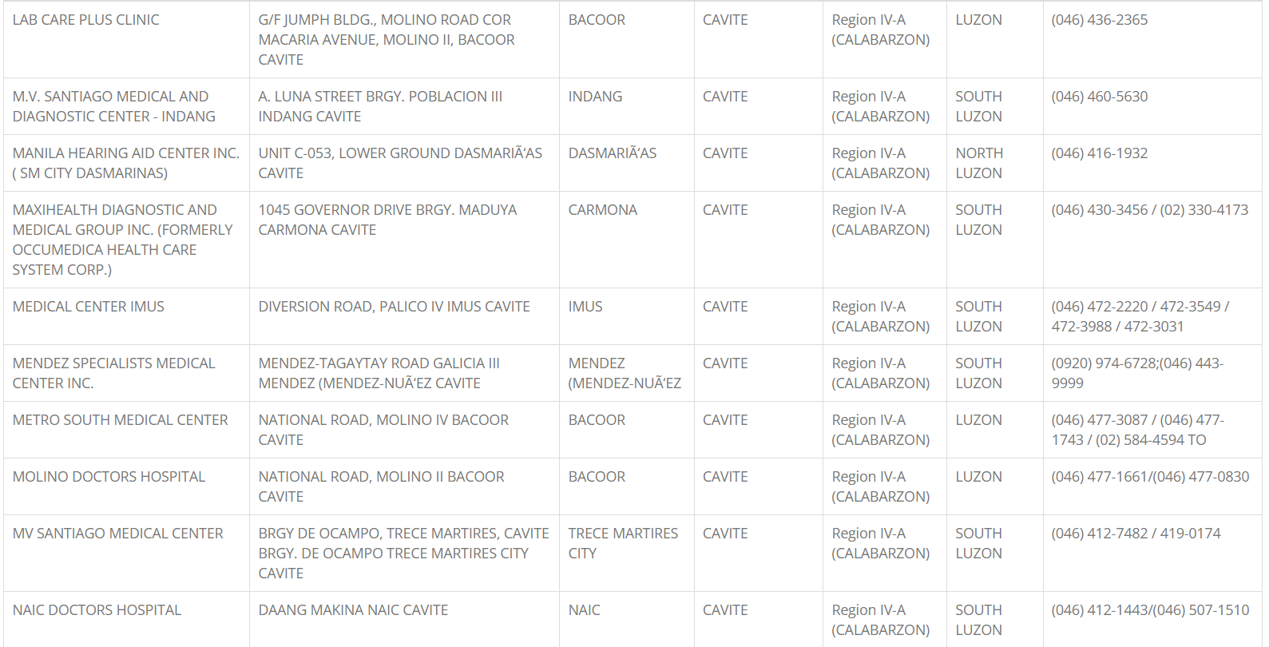

Slide 36
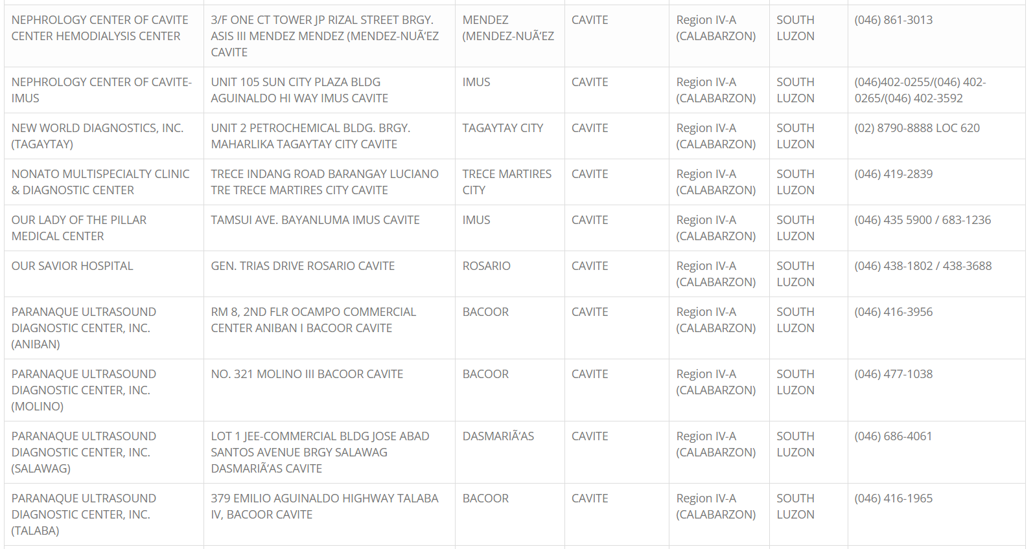

Slide 37
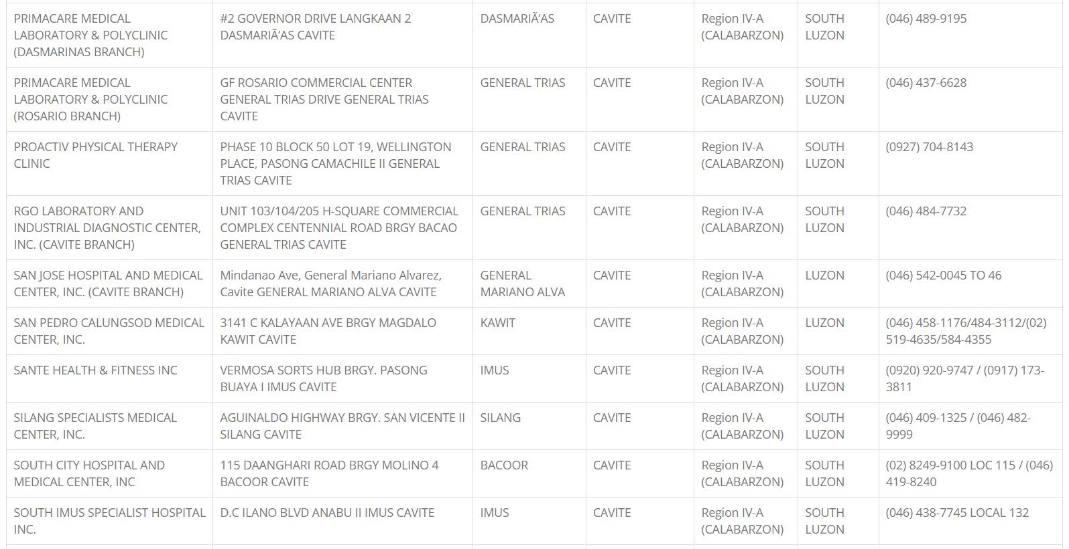

Slide 38
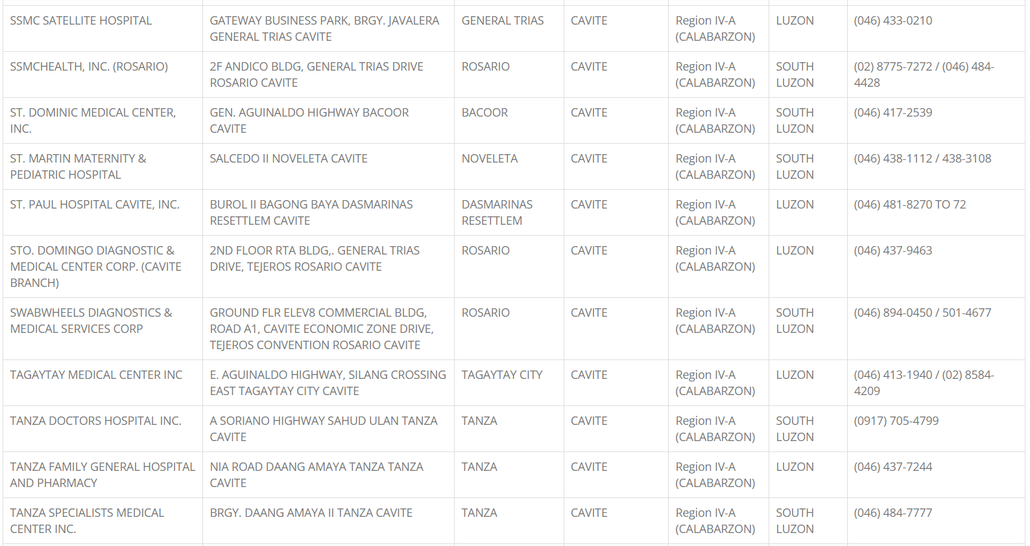

Slide 39
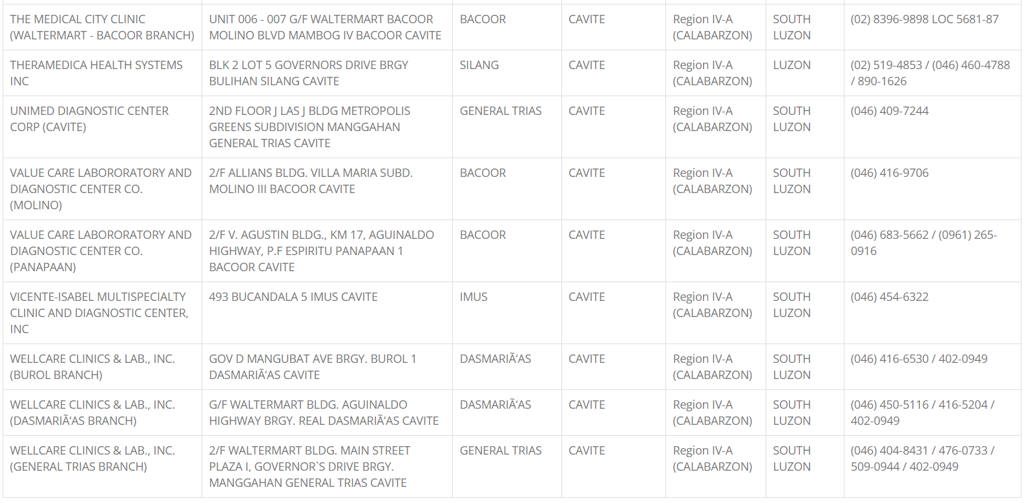

Slide 40
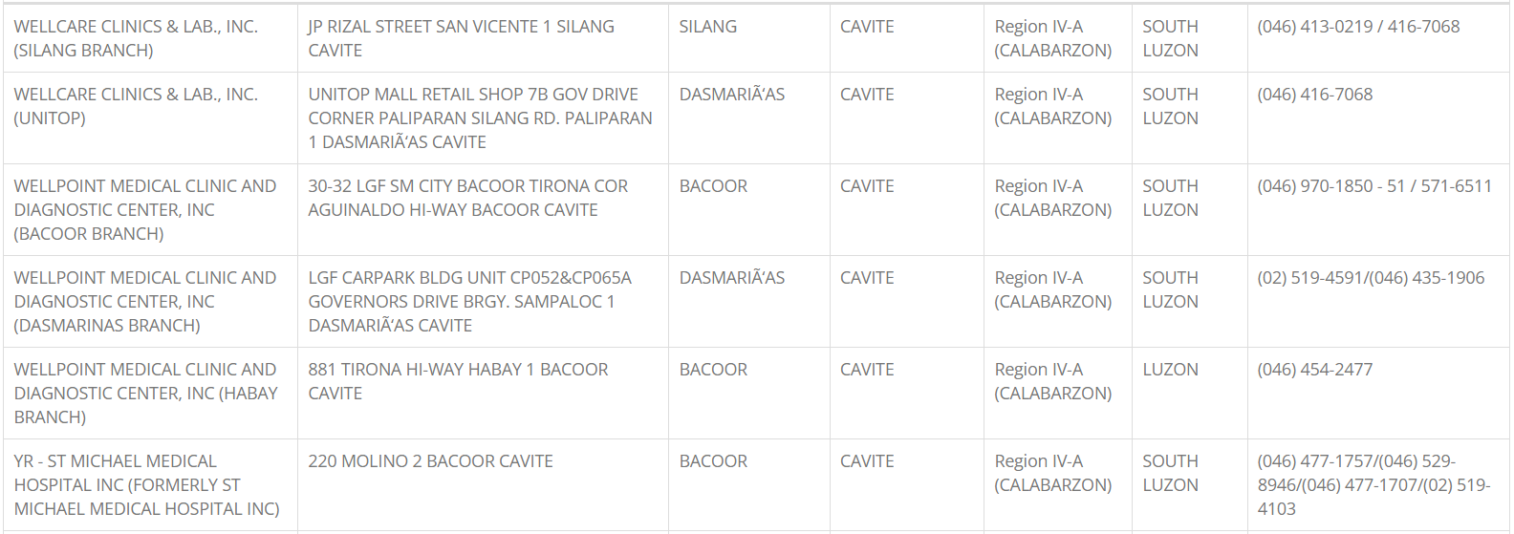

Slide 41
Accredited - Hospitals
Laguna

Slide 42
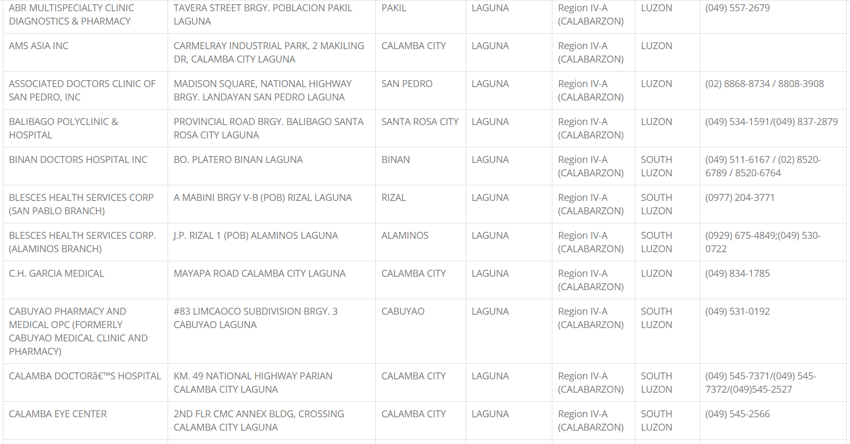

Slide 43
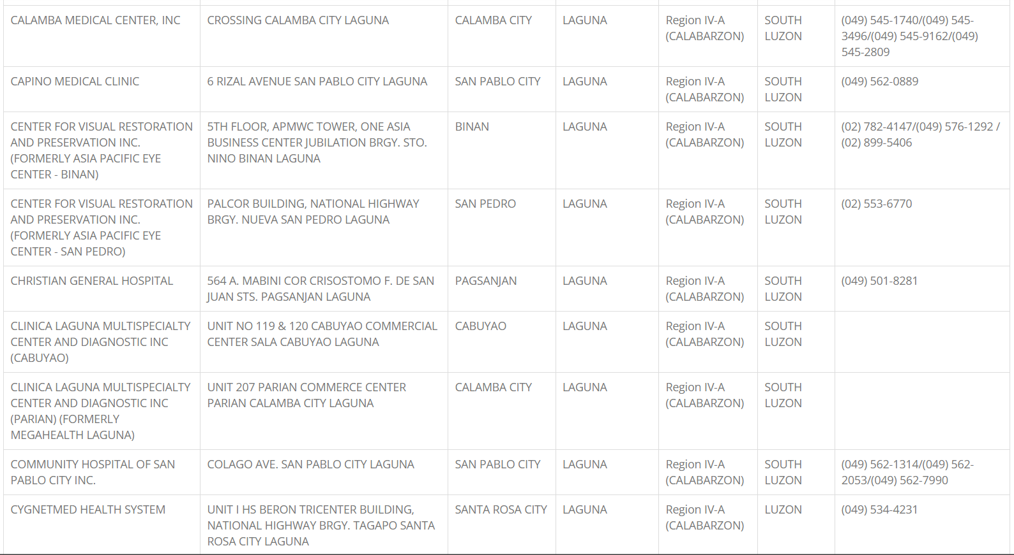

Slide 44
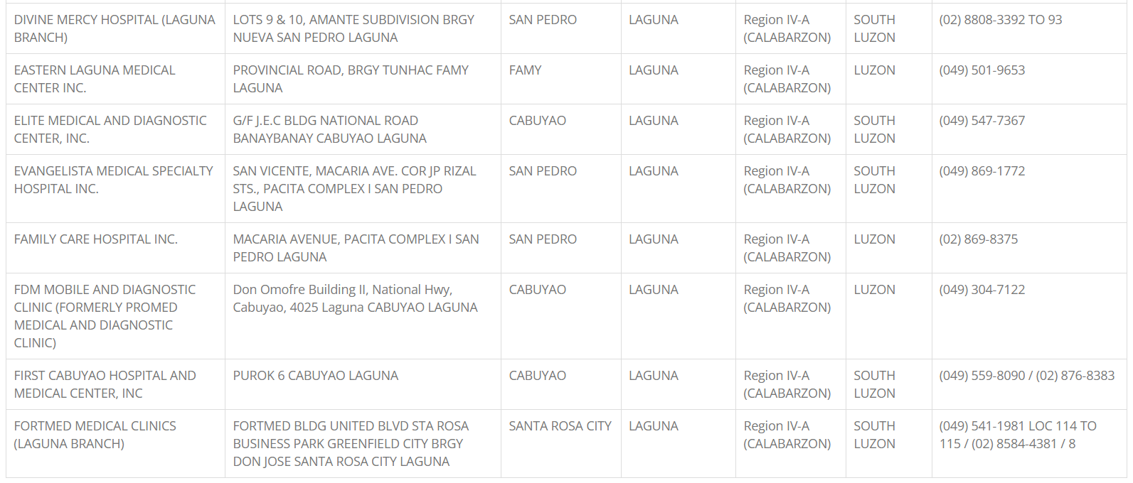

Slide 45
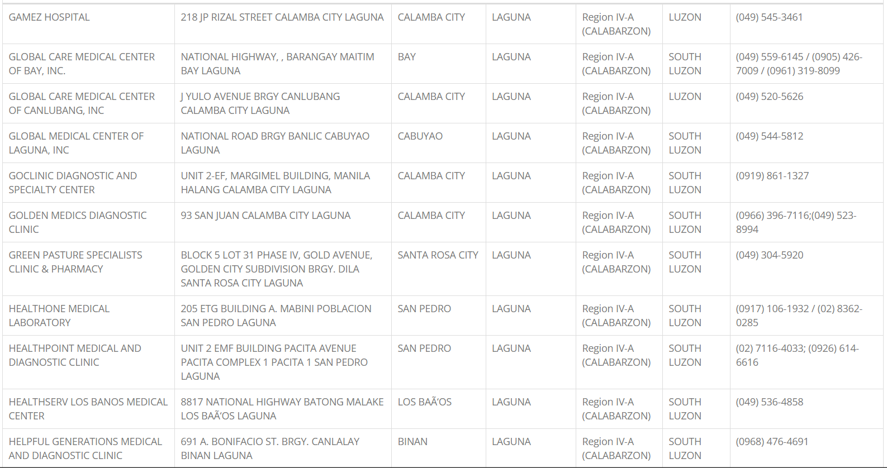

Slide 46
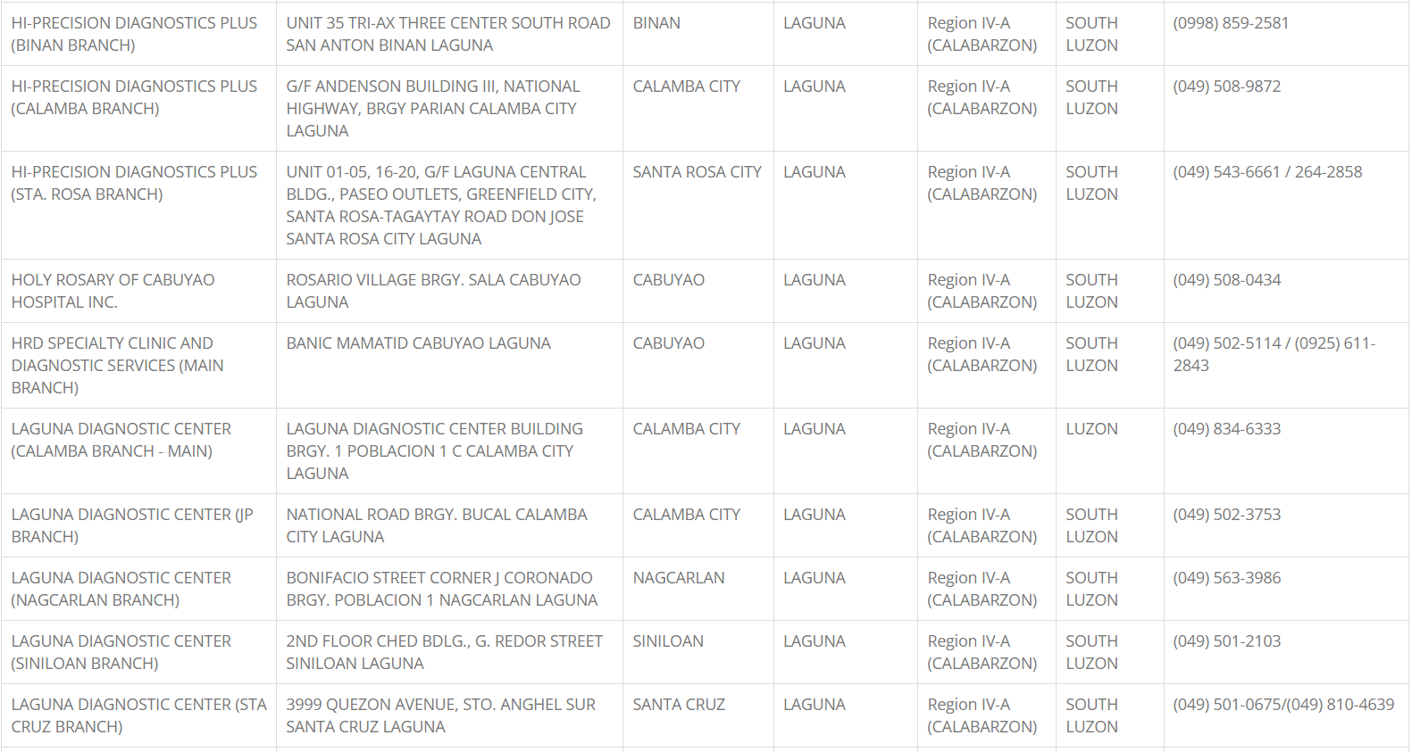

Slide 47
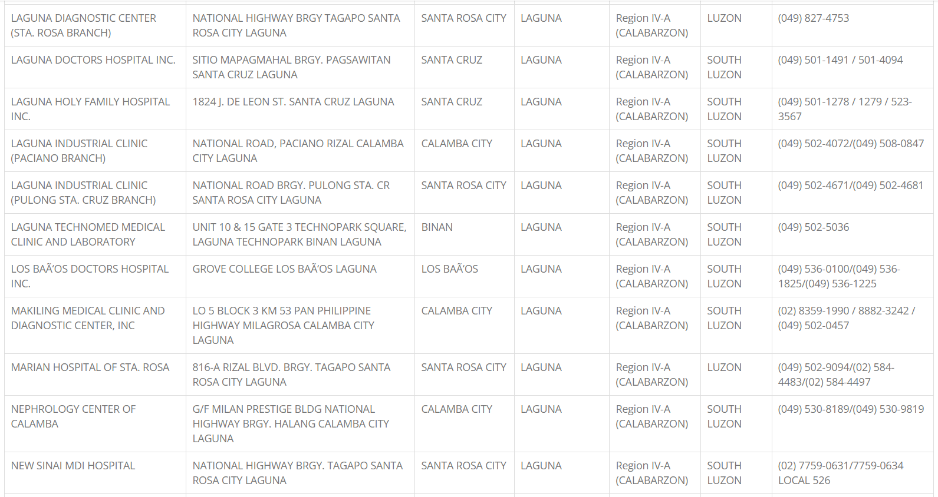

Slide 48
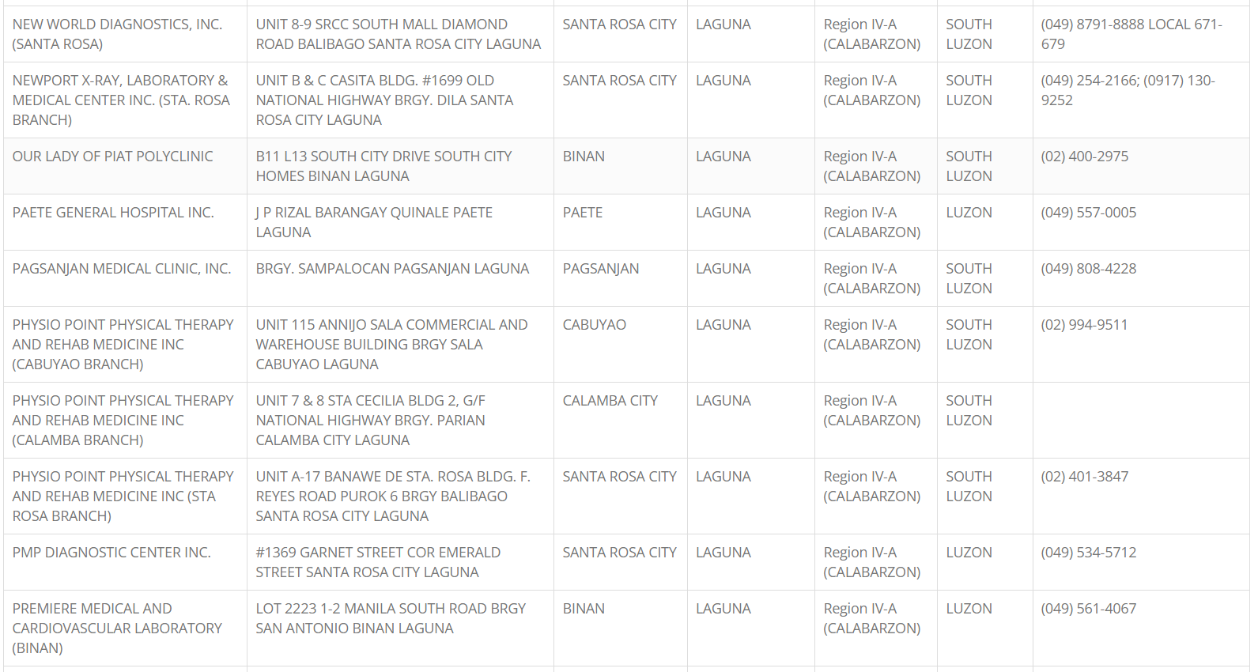

Slide 49
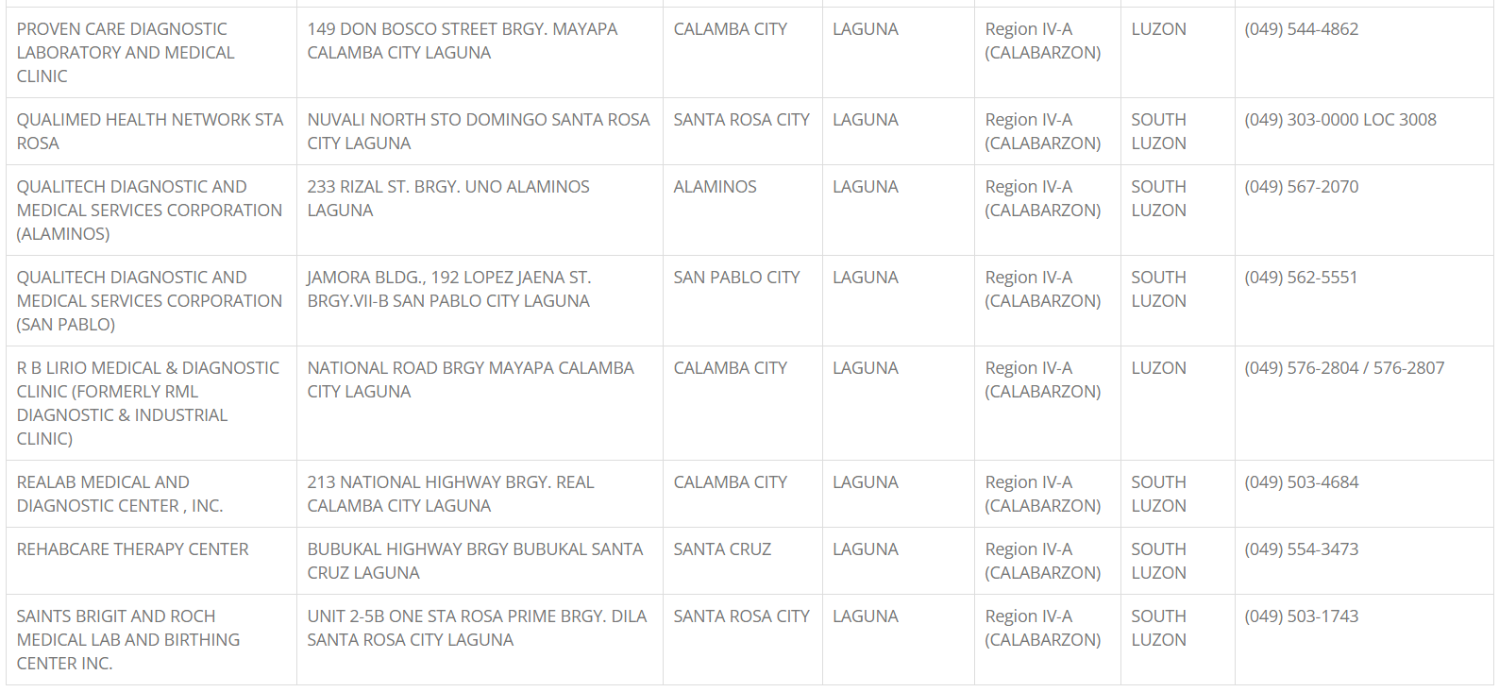

Slide 50
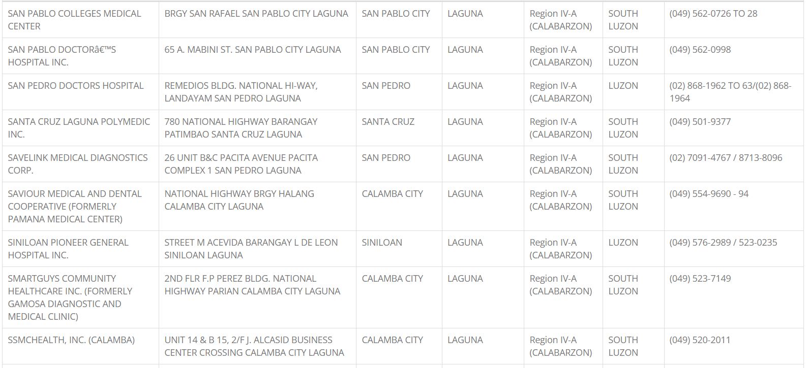

Slide 51
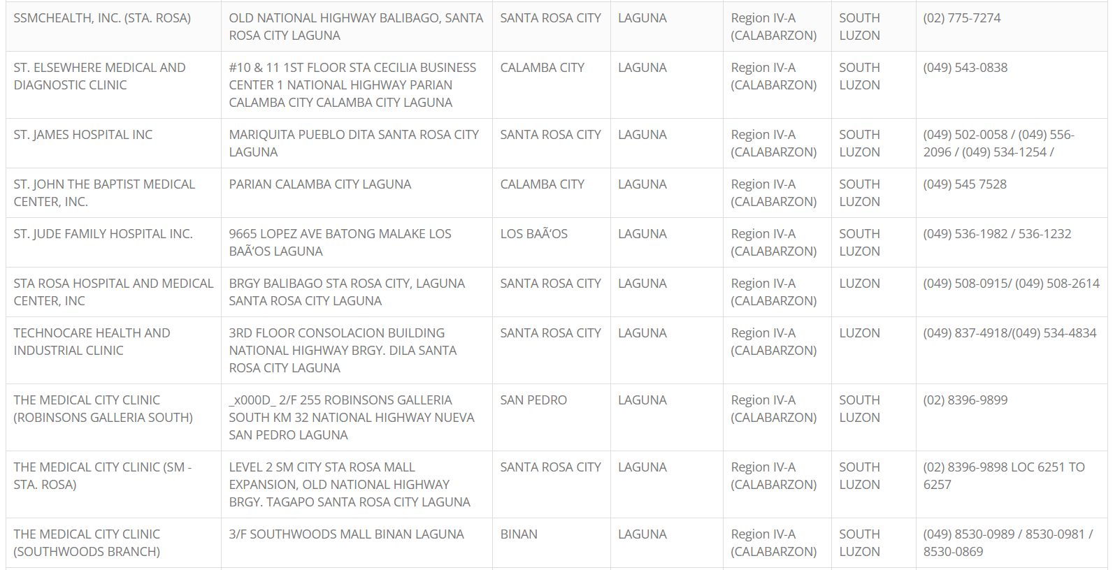

Slide 52
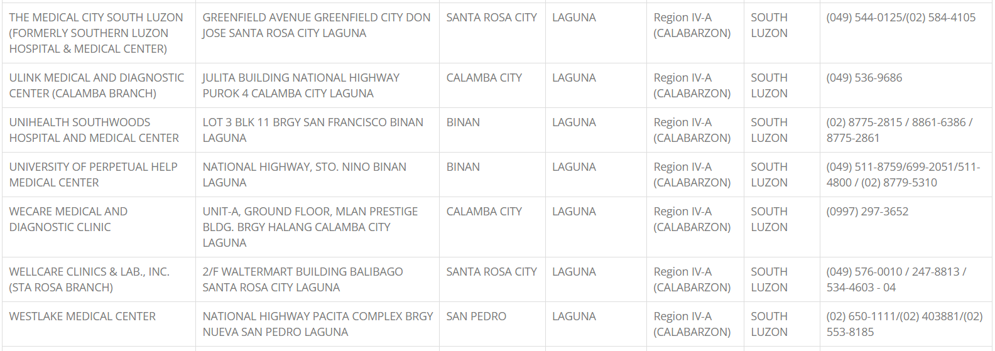

Slide 53
Accredited - Hospitals
Quezon

Slide 54
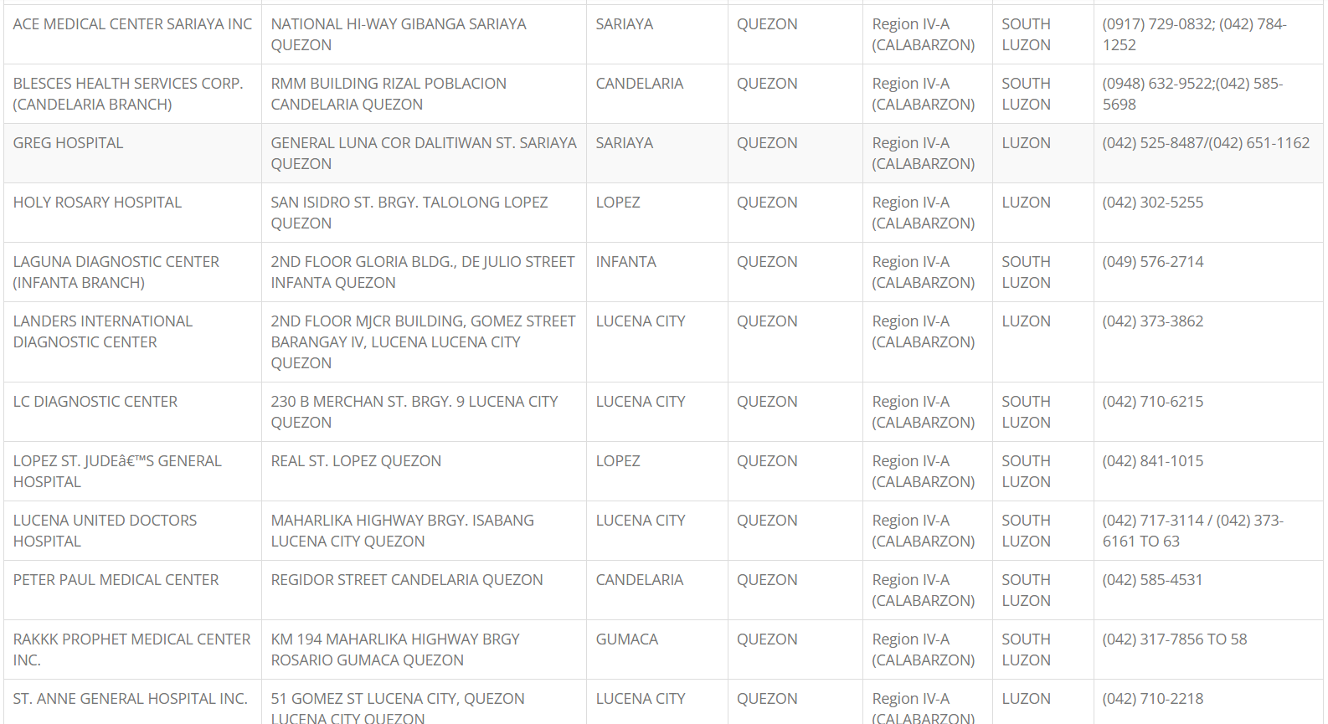

Slide 55
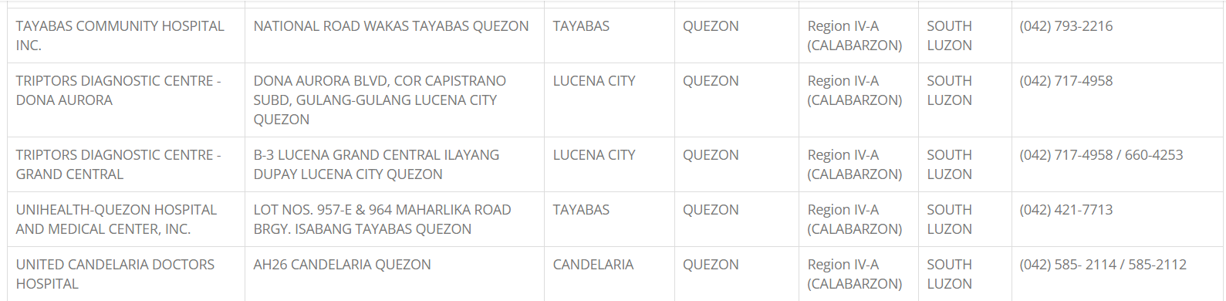

Slide 56
Accredited - Hospitals
Rizal

Slide 57
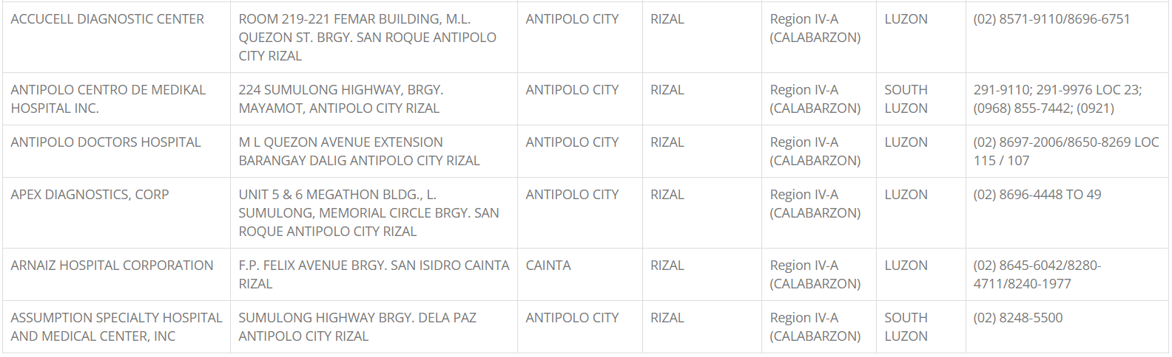

Slide 58


Slide 59


Slide 60


Slide 61


Slide 62


Slide 63


Slide 64


Slide 65

PHILCARE PREFERRED
HMO
PLAN
By
DIS
-All
Care
Marketing
Welcome
to
Your
Journey
to
Wellness
THANK YOU
CONTACT US: 09914372822 - 09953316753 - (043) 3493044
Zenna O. Aranda
LOCATED AT: ATDRMAM BLDG. 3RD FLOOR RM. 304 J.P. LAUREL ST. AYALA HIGHWAY MATAAS NA LUPA LIPA CITY BATANGAS

